Slide 1

Predicting Sales Conversion Likelihood using Machine Learning
AI-Driven Prioritization of Sales Leads
Presented by Subramanya Rithwik Jakka

Slide 2
The Business Challenge: Inefficient Sales Prioritization
The company B2B sales cycle often faces inefficiency due to significant lead drop-off. Without an intelligent prioritization mechanism, sales teams spend valuable time on leads with low conversion potential, leading to:
Suboptimal resource allocation
Reduced sales productivity
Missed opportunities for high-potential leads
Our objective is to leverage data to improve ROI and focus our sales efforts more effectively.

Slide 3



Project Objective & Scope
Build a Predictive ML Model
Classify Lead Priority
Support Data-Driven Strategy
Develop a robust machine learning model to predict the probability of lead conversion into paying customers.
Categorize new leads into distinct priority levels: High, Medium, and Low, based on their predicted conversion likelihood.
Enable sales and marketing teams with actionable insights for optimized lead nurturing and outreach strategies.

Slide 4

Dataset Overview: The Foundation of Our Model
Our model is built upon a comprehensive dataset sourced from the PostgreSQL , capturing a wide range of lead characteristics.
Key Data Points:
37 input features: Spanning lead behavior, demographics, and historical interactions.
Significant features:
Lead Origin: Where the lead originated (e.g., web, referral).
Lead Source: Specific channel (e.g., Google Ads, direct traffic).
TotalVisits: Aggregate website visits by the lead.
Total Time Spent on Website: The total time spent by the customer
on the website.
Converted: The target variable (binary: Yes/No).
Tags: Manual tags assigned by sales representatives.

Slide 5
Data Cleaning, Preprocessing, Feature Selection & Engineering
1
2
Data Cleaning
Feature Selection
Removed duplicate rows, addressed null values, standardized categorical labels, and removed irrelevant features to ensure data quality and Mapping the labels of the columns with similar meaning
Dropped unnecessary features ('Prospect ID', 'Lead Number’)
Removed features which contains contains constant value
(e.g. "Magazine", "Receive More Updates About Our Courses",)
Removed insignificant features (e.g. 'Newspaper', 'Newspaper Article’, 'X Education Forums',)
3
4
Feature Engineering
Data Preprocessing
Used Winsorization to cap extreme values in numeric columns.
Applied SimpleImputer — mean for numeric, most frequent for categorical and ordinal features.
Used Ordinal Encoding for ordered categories and OneHotEncoding for nominal categories
Applied Yeo-Johnson Power Transformation and MinMaxScaler to normalize numeric features..
Engineered features by combining existing variables to uncover synergistic effects (e.g., Engagement Score (weighted average of 'Total Time Spent on Website', 'Page Views Per Visit', 'TotalVisits’ and 'Combined Asymmetrique Score’ which is summation of 'Asymmetrique Activity Score', 'Asymmetrique Profile Score’ ).

Slide 6
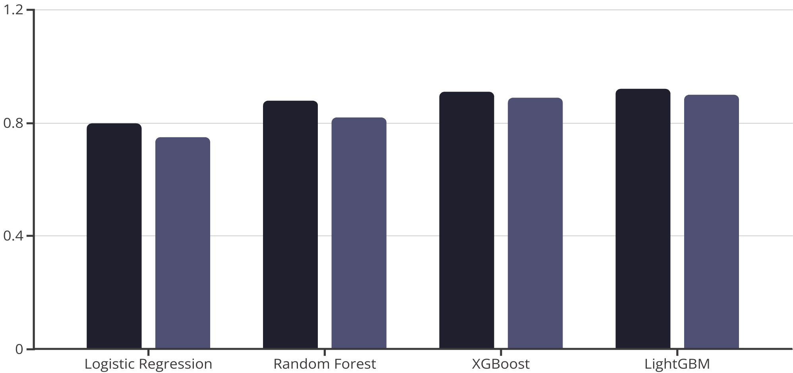
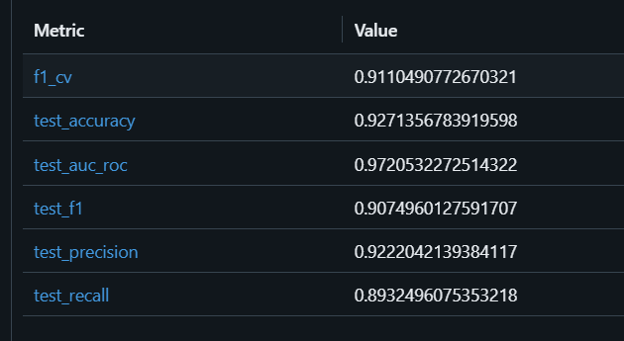
Model Training & Evaluation
I trained and evaluated several machine learning models to identify the most performant solution:
Models Tested: Logistic Regression, Random Forest, XGBoost, and LightGBM.
Evaluation Metrics: Focused on Accuracy for overall correctness and Precision for Class 1 (Converted Leads) to minimize false positives.
Best Model: LightGBM consistently outperformed other models, achieving the highest accuracy and precision for predicting conversions.
Accuracy
Precision (Class 1)

Slide 7
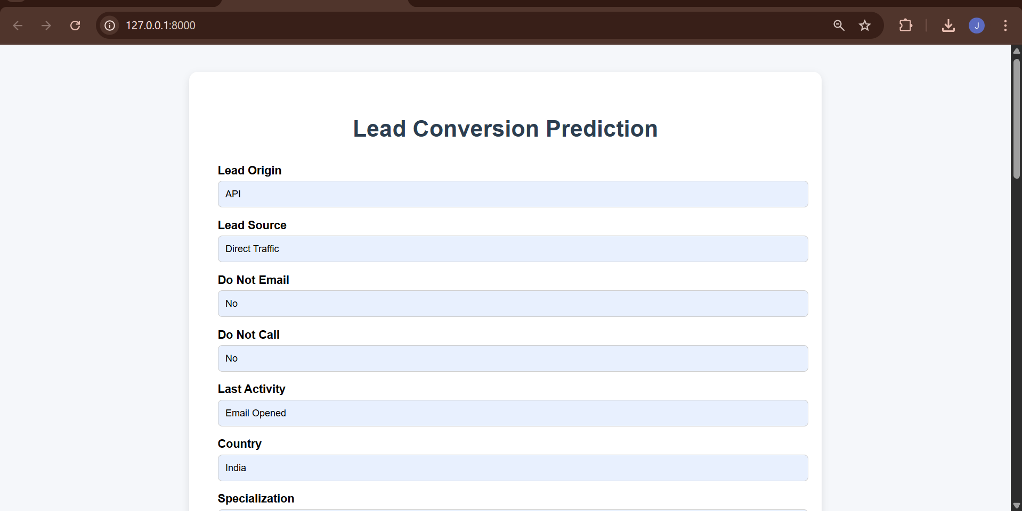
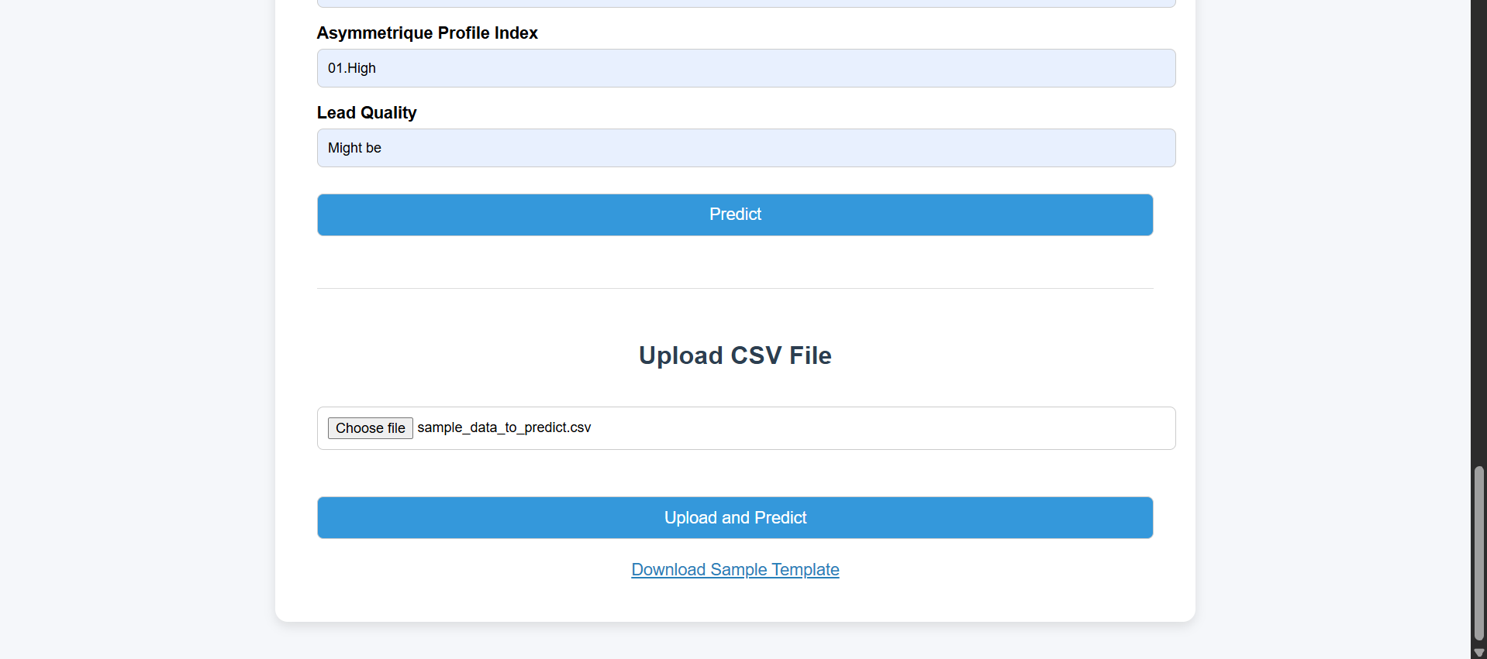
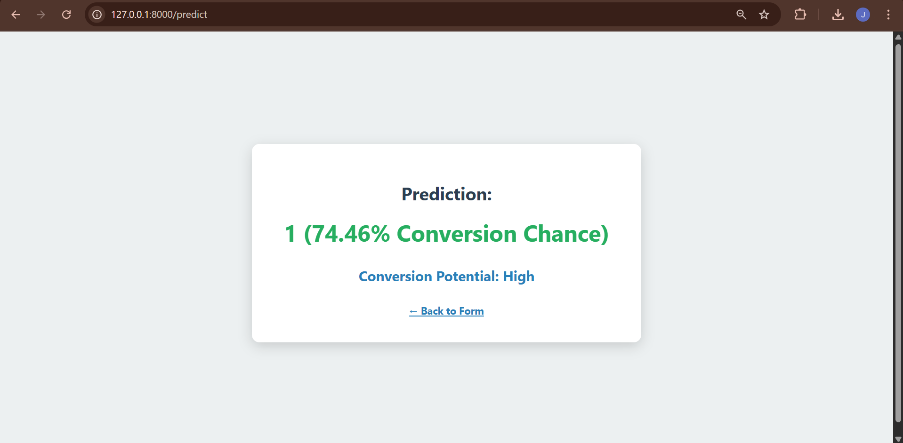
Deployment & User Interface
To make the model accessible, we've deployed it via a Flask web application:
Input Methods: Users can input lead data through a form-based interface for single predictions or upload CSV files for batch processing.
Prediction Output: The application predicts the conversion probability and classifies leads into High, Medium, or Low priority.
Data Storage: Prediction results are saved back to PostgreSQL for easy access and integration.
Model Management: The deployed model is retrieved from our MLflow Registry, ensuring version control and traceability.

Slide 8
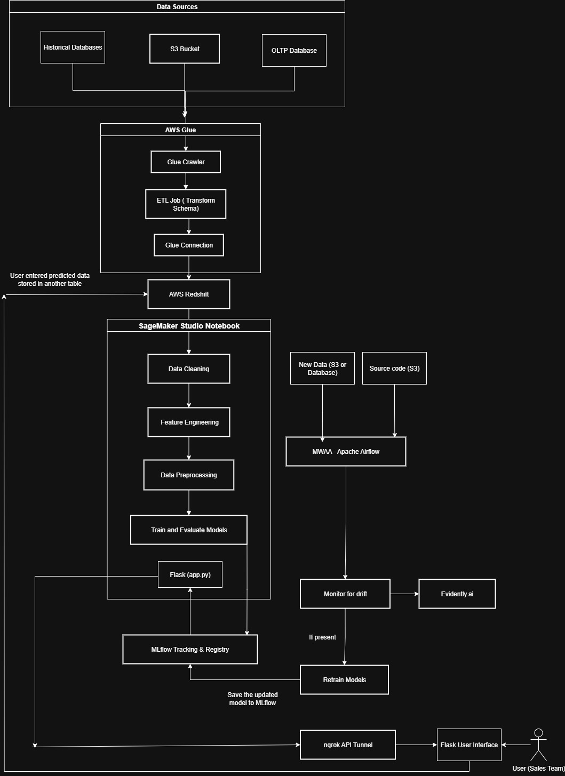
Architecture Diagram in AWS Cloud Implementation:

Slide 9




Automated Monitoring & Retraining
Drift Detection with Evidently AI
Airflow DAGs for Orchestration
We use Evidently AI to continuously monitor for data and concept drift by comparing new incoming data to the training dataset's characteristics.
1
Apache Airflow DAGs (Directed Acyclic Graphs) are configured to automate the monitoring process and trigger subsequent actions.
2
Ensuring Model Relevance
Conditional Retraining
This automated system guarantees that our predictive model remains accurate and relevant as underlying lead behaviors and market conditions evolve.
4
If the detected drift exceeds a predefined threshold, the Airflow DAG automatically initiates the model retraining pipeline.
3

Slide 10
Business Value & Future Work
Tangible Business Value:
Future Enhancements:
Optimized Sales Targeting: Direct sales efforts to the most promising leads.
Real-time API Integration: Provide instant predictions for immediate sales actions.
Reduced Waste: Minimize time spent on low-potential leads.
Lead Profile Enrichment: Incorporate external data sources for deeper insights.
Improved Conversion Rate: Drive higher overall sales conversions.
Uplift Modeling: Predict the incremental impact of interventions on conversion.
Enhanced ROI: Maximize returns on marketing and sales investments.
A/B Testing Strategies: Validate the effectiveness of prioritized lead strategies.
Key Takeaway: This project empowers our sales team with a data-driven edge, transforming lead management into a precise, high-impact operation.

